Slide 1

M.Sc. (Integrated) Five Years Program
AIML/Data Science
Semester - VII
Department of AIML & Data Science
School of Emerging Science & Technology
SUBJECT CODE: CC-406
Subject Name: PROJECT -II: Project
MedRec: Medical Report Data Extraction & Maintenance Application
MEMBERS:
SHRUTI HEMANT AGARWAL (DS-01)
PRABLEEN KAUR SANDHU (DS-12)
RADHIKA SHIVKUMAR SHARMA (DS-15)
ESHA MISHRA (AIML-09)

Slide 2


OUTLINE
PROBLEM DEFINITION
OBJECTIVE
INTRODUCTION
PROJECT WORKFLOW
METHODOLOGY
OUTPUT
CONCLUSION
FUTURE WORK
REFERENCES

Slide 3
PROBLEM DEFINITION
For any significant diagnosis or prescription, patient's medical report are a must. On an average a person gets at least 5 tests done every year. India is the diabetes capital of the world with 77 million formally diagnosed patients. These people need to get their blood glucose levels regularly tested. Patients with chronic illnesses like thyroid disorder, PCOS/ PCOD get tested every 3 months. Physical file maintenance of these medical reports is laborious and they are easy to misplace or missing when one need them. Maintaining these reports becomes more challenging with time.

Slide 4
OBJECTIVE
The project's main objective is to develop an end-to-end solution for storing and maintaining medical reports using deep learning algorithms and image processing.

Slide 5
INTRODUCTION
80% of all healthcare data is unstructured and inaccessible for further processing. This limits the quantity of usable data and also limits a healthcare organization’s decision-making capabilities. According to a study, 30% of healthcare costs are associated with administrative tasks. AI can automate some of these tasks. The global healthcare AI market size is expected to grow from USD 3.64 billion in 2019 to USD 33.42 billion by 2026, at a Compound Annual Growth Rate (CAGR) of 46.21% during the forecast period.

Slide 6
AI-enabled systems are not going to completely replace human medical experts. But this technology will enhance their capabilities and effectiveeness by automating the most repetitive activities prone to errors.
Archiving is the process of securely storing inactive information in any format that you no longer use regularly for long-term retention. Such information is still important to organizations and must be retained for future reference or regulatory compliance.
Medical report storage is a practical solution to free up space while keeping records safe, ensuring they are not lost, stolen, or damaged.

Slide 7
For life-saving documents like medical records, there is no solution available that allows easy access to patient medical history. In case of a medical emergency, easy and fast access to medical history reduces diagnosis time and enables doctors to get the treatment quickly. Big hospitals have their own softwares which will not be accessible to other medical institutions outside the hospital network. Thus, there is a need for a solution that's accessible to all.

Slide 8
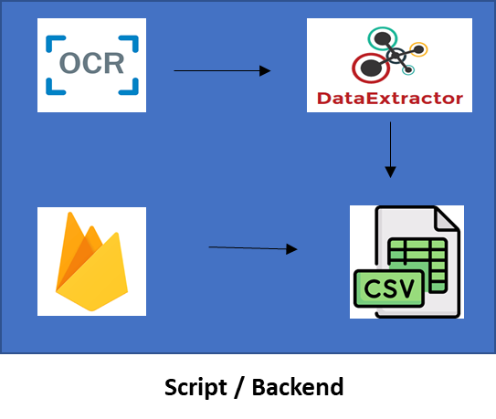
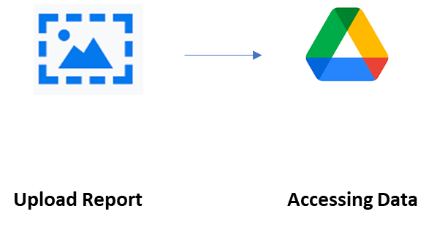


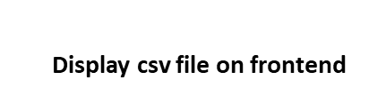
Workflow

Slide 9
Methodology
1
DATA COLLECTION
2
LIBRARIES USED
3
DATA AUGMENTATION
3
4
DATE EXTRACTION AND PREPROCESSING
5
DATA STORING
FRONT END
6

Slide 10
1
Collecting Images of medical reports of various tests like blood glucose level, thyroid, urine test, CBC etc. All reports are taken with patient consent and they are aware of the use of these reports.
DATA COLLECTION

Slide 11
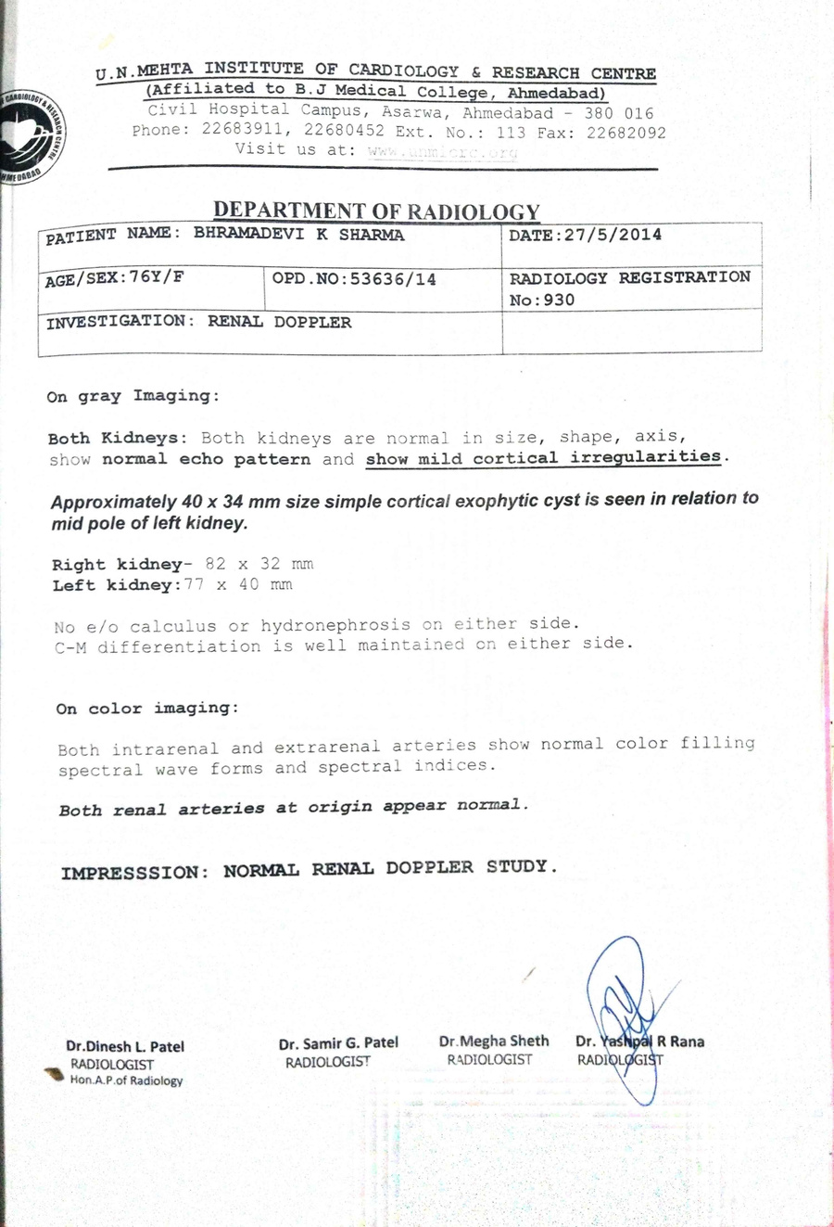
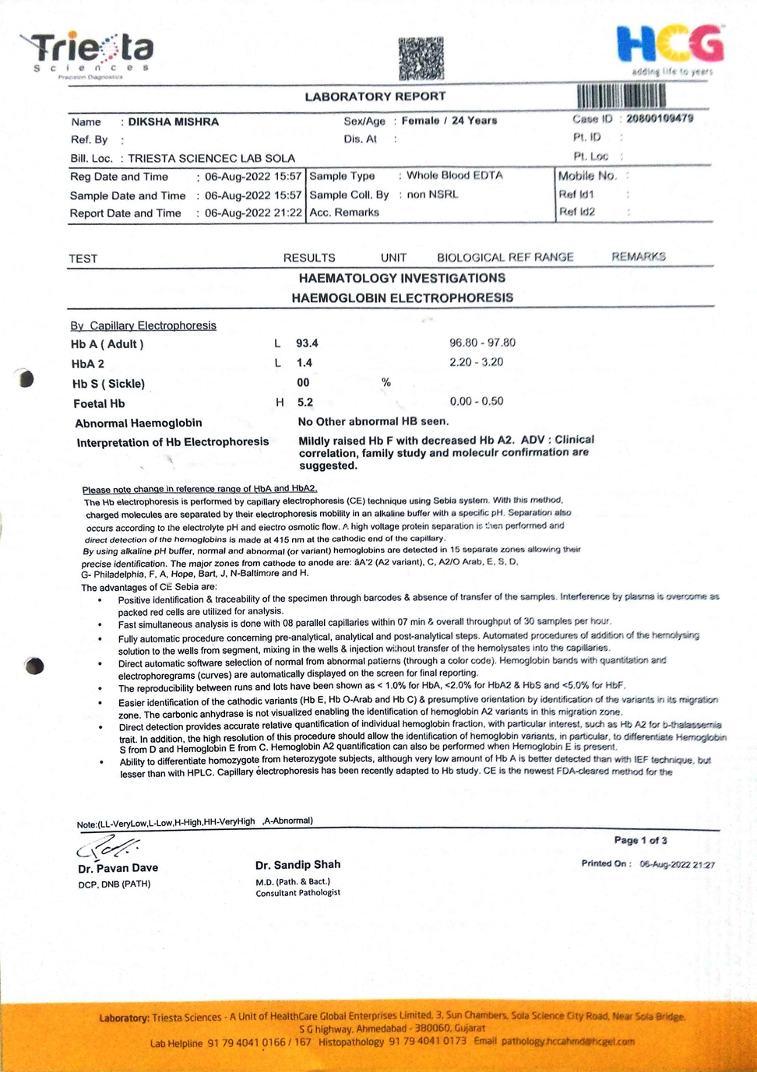
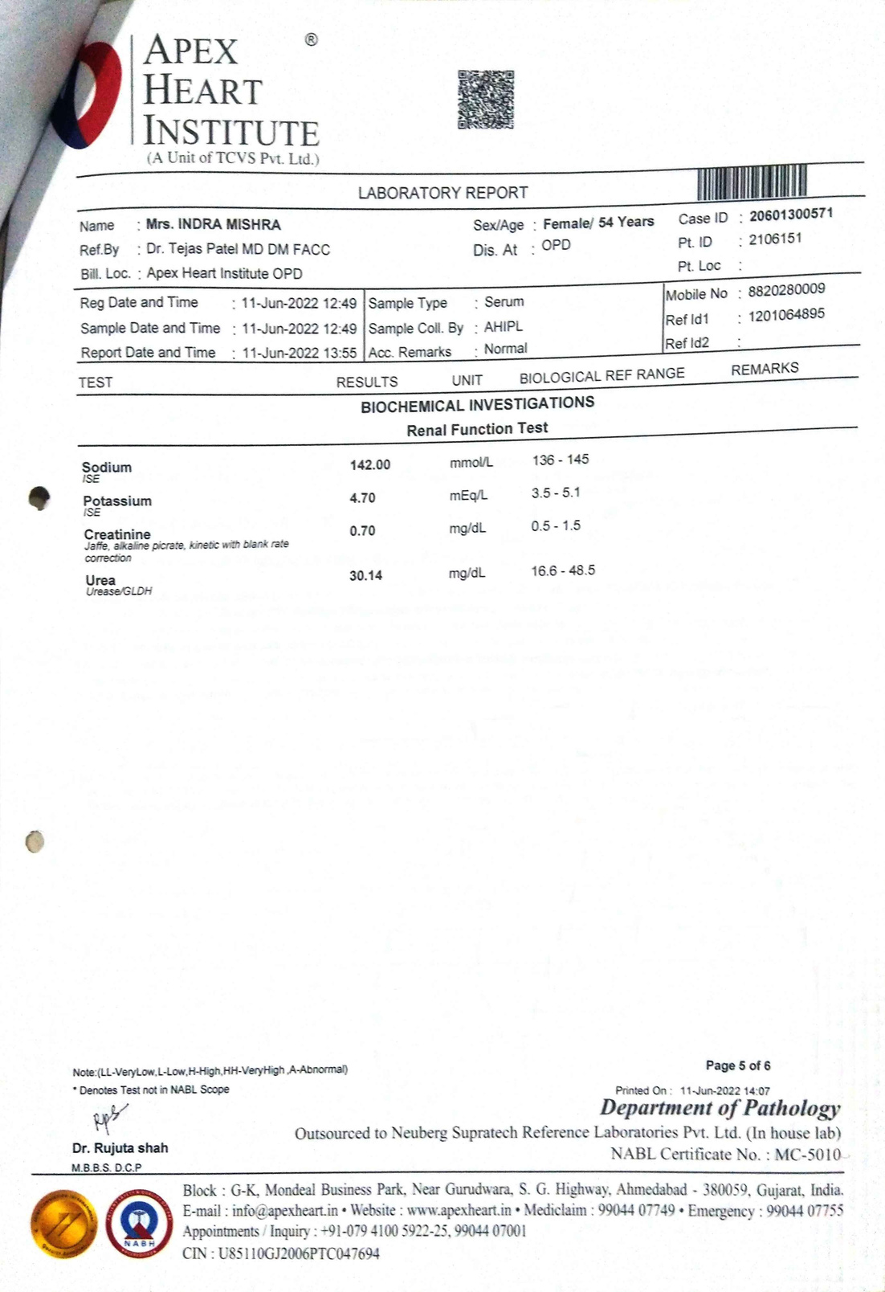

Slide 12
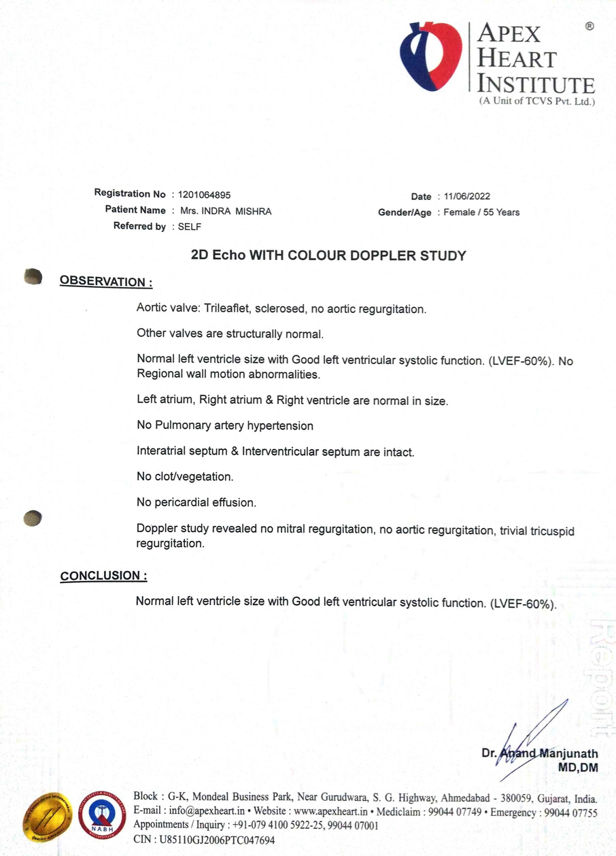
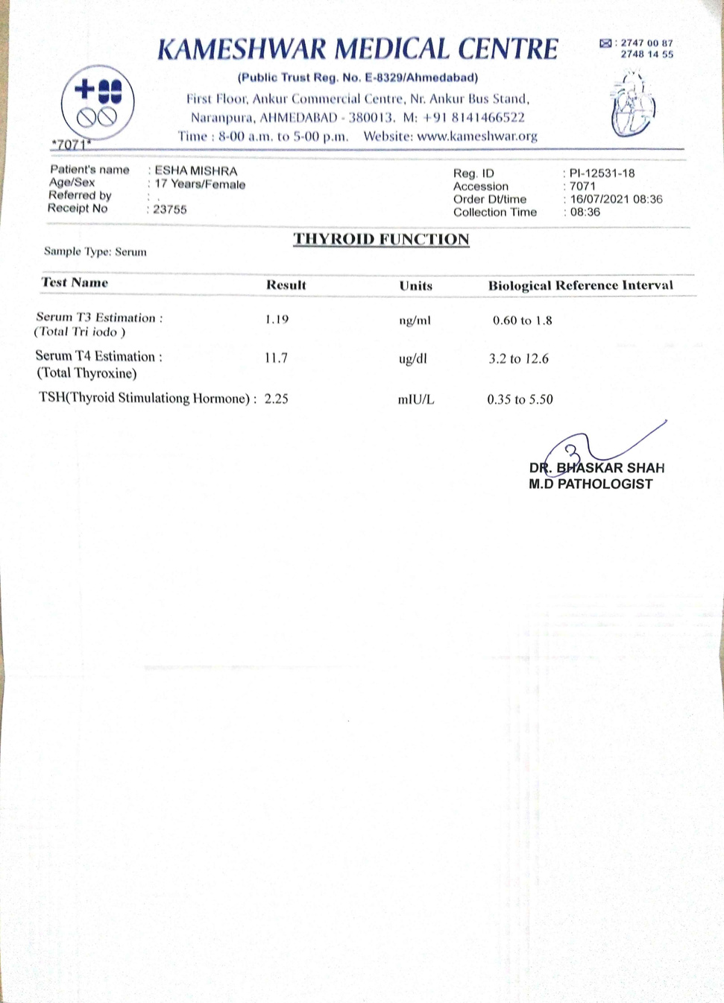
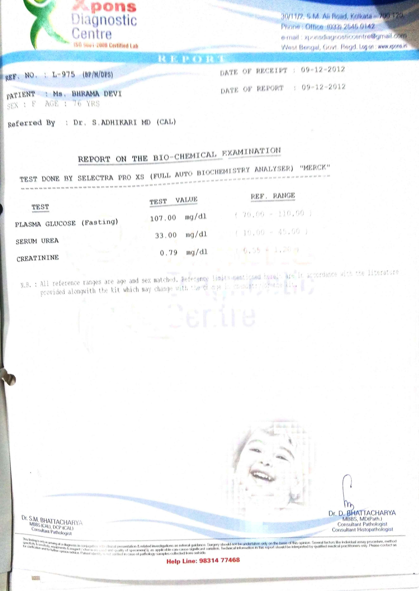

Slide 13
2
Pandas
Numpy
Glob
Datepasser
Tensorflow
Augly
Opencv
PIL
Matplotlib
Pytesseract
Datetime
Pyrebase
LIBRARIES
USED

Slide 14
2
3
Data augmentation is a technique used to increase the size and diversity of a dataset by generating new data samples from existing ones. The goal of data augmentation is to improve the performance of a model by providing it with more diverse training data.
DATA AUGMENTATION

Slide 15
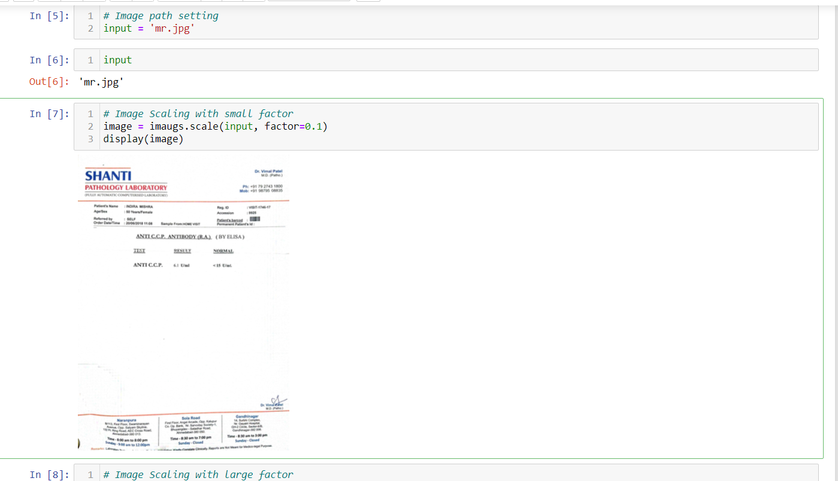

Slide 16
2
To Extract data from image we used OCR (Optical Character Recognition).
Pre-trained model from pytesseract was used to perform OCR on images.
search_dates() from dateparser is used for date extraction.
This extracted data is then processed and invalid dates are filtered out.
4
DATE EXTRACTION AND
PREPROCESSING

Slide 17
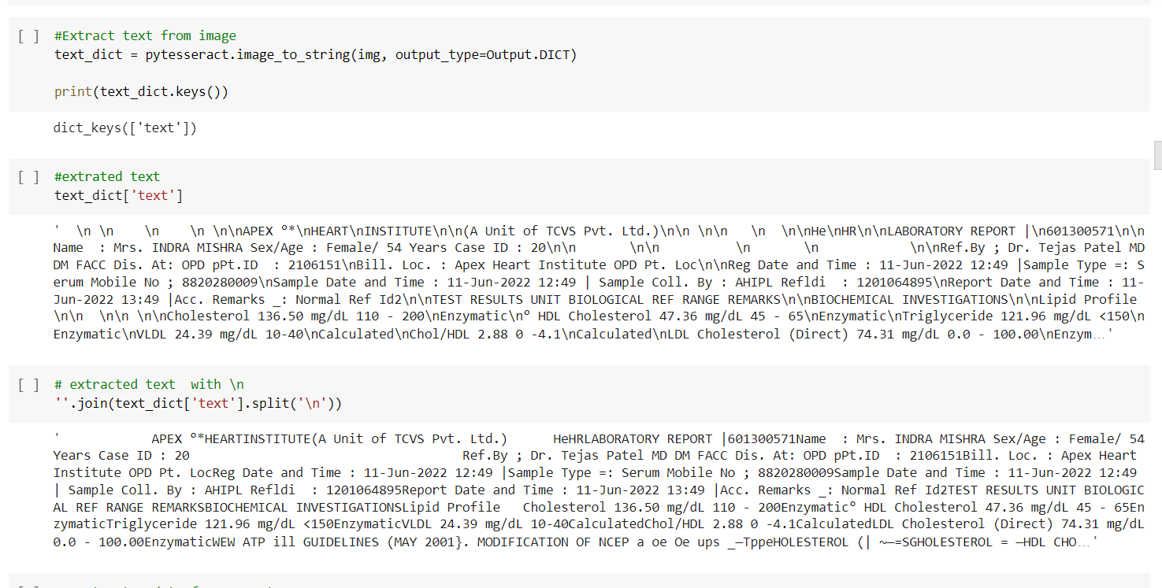

Slide 18
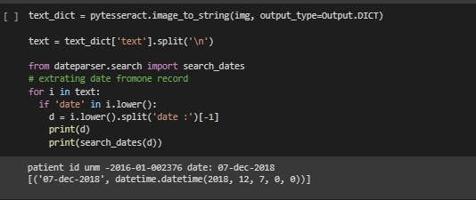
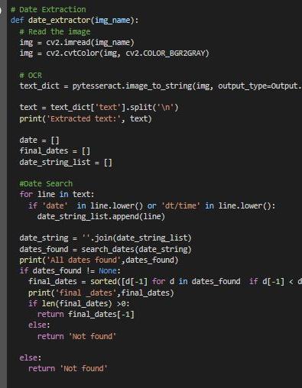
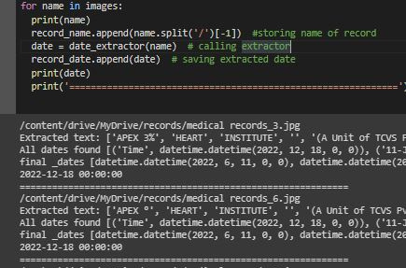

Slide 19
5
Extracted and cleaned information is converted into csv file format and stored in the database.
For storing data, Firebase is used as it allows us to save data in a much more efficient manner.
DATA STORING

Slide 20
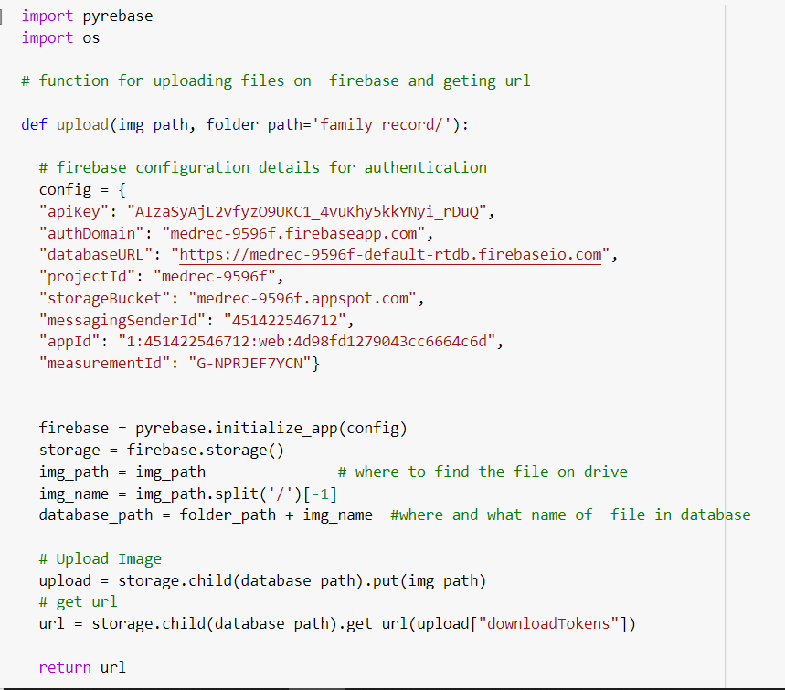

Slide 21
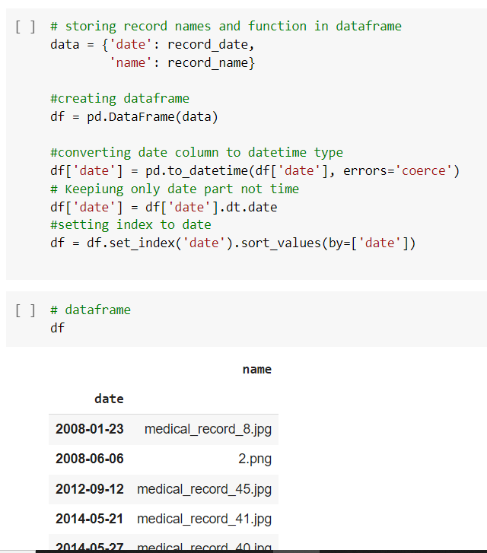

Slide 22
6
For front end we have build a html web page. We have created an authentication page, home page and display page .
On display Page the extracted csv file is displayed.
FRONT END

Slide 23
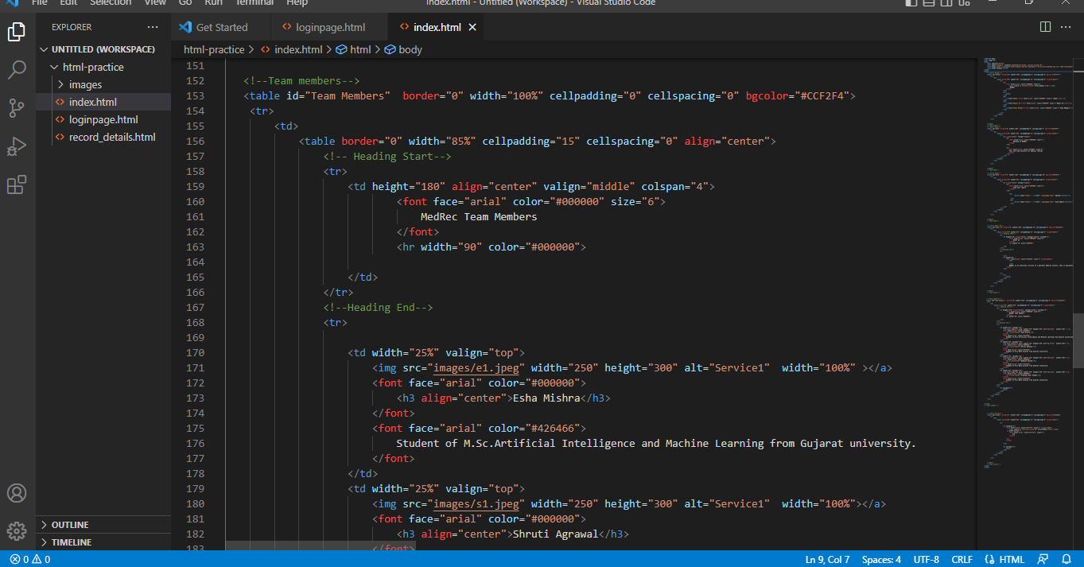

Slide 24
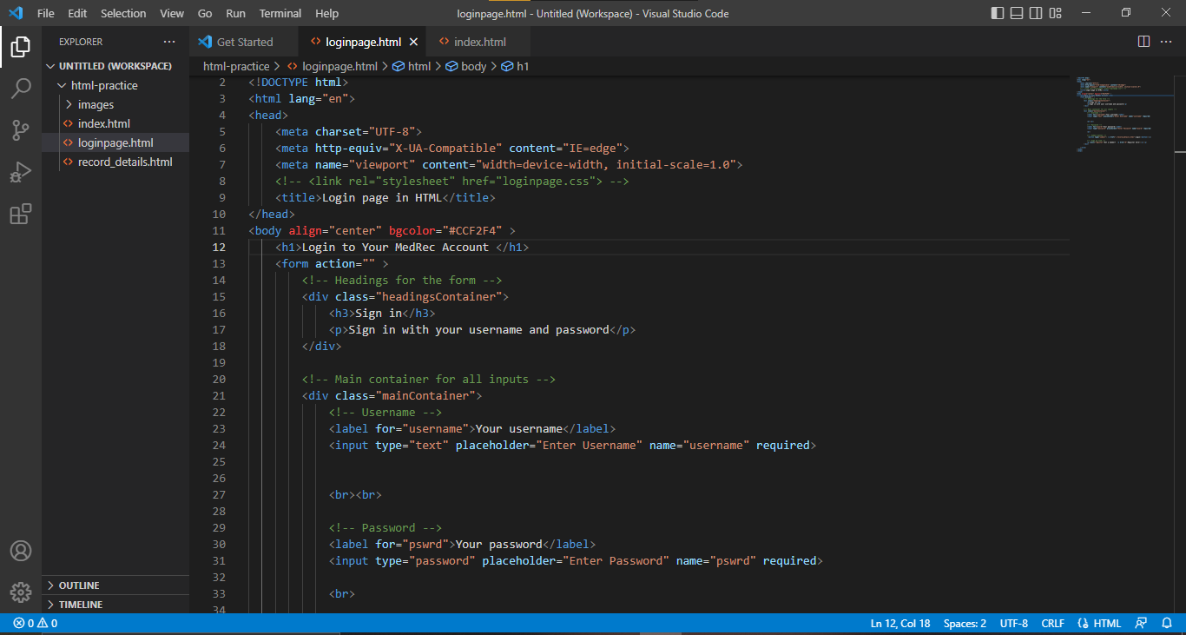

Slide 25
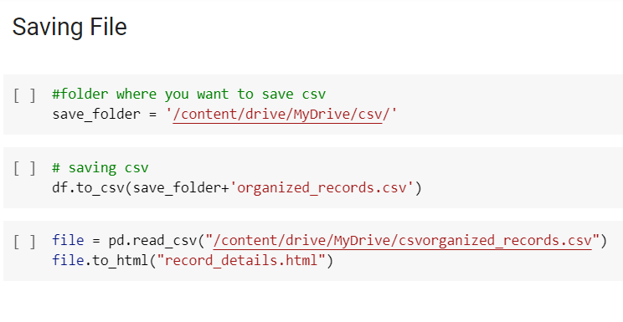

Slide 26
OUTPUT
The output is a csv file with record date, name and url.
Date helps in organising the documents and url provides easy access to the record image.
Date extracted is not always accurate and can be improved. For best results the digital image of the document should be clear.

Slide 27
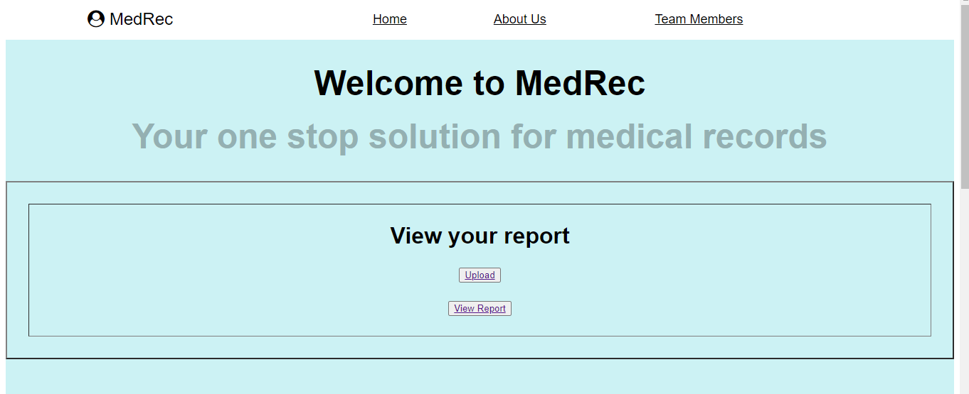

Slide 28


Slide 29
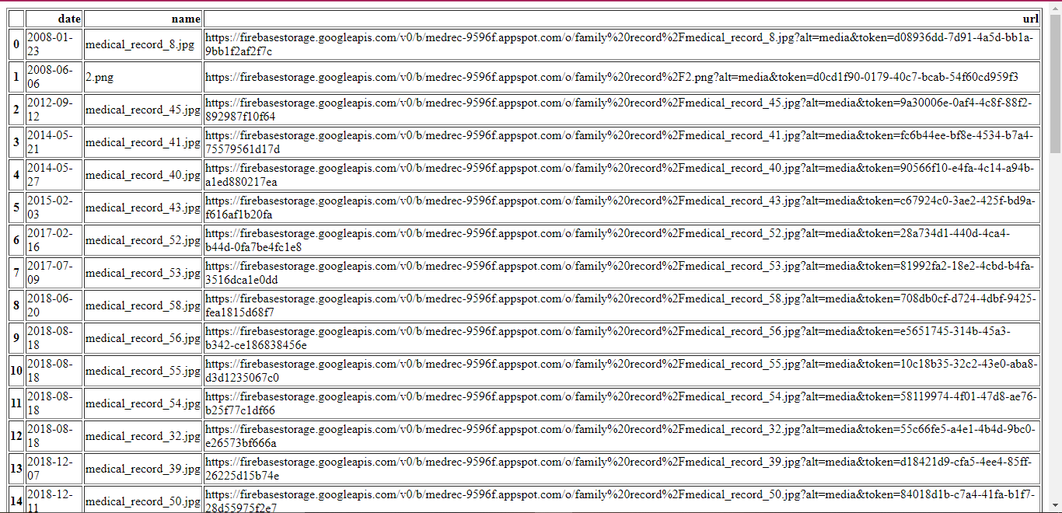

Slide 30
CONCLUSION
Medical records are very important life saving documents. Maintaining them is a laborious task. Archiving is used for long term information storage. It has two parts to it. 1.Storing the information so that it is never lost. 2. Easy access to information. Our solution uses firebase by google for storage. The extracted date from medical record images is used to organize the records and save them in a csv file where users can access the record using the given URL. This will help users to store data at a single platform and thus reduce the storage cost and burden of maintaining data physically.

Slide 31
FUTURE WORK
Improve accuracy of date extraction function.
A dynamic system that works in real time.
Authentication for privacy and security.
Work on the frontend.

Slide 32
REFERENCES
Bajaj Finserv Health. (2022, March 09). Unified Health Interface: Services, Benefits & Registration. Bajaj Finserv Health. Retrieved December 18, 2022, from https://www.bajajfinservhealth.in/articles/unified-health-interface
Data Archives and Why You Need Them. (n.d.). Cloudian. Retrieved December 18, 2022, from https://cloudian.com/guides/data-backup/data-archive/
Improve patient experience with custom medical records management. (n.d.). OSP Labs. Retrieved December 18, 2022, from https://www.osplabs.com/medical-records-management/
MySirG-official/html-project: HTML only Page. (2020, November 25). GitHub. Retrieved December 18, 2022, from https://github.com/MySirG-official/html-project
Personal health records and patient portals. (n.d.). Mayo Clinic. Retrieved December 18, 2022, from https://www.mayoclinic.org/healthy-lifestyle/consumer-health/in-depth/personal-health-record/art-20047273
thisbe jim/Pyrebase: A simple python wrapper for the Firebase API. (n.d.). GitHub. Retrieved December 18, 2022, from https://github.com/thisbejim/Pyrebase

Slide 33
ANY
QUESTIONS?

Slide 34
THANK YOU

